Slide 1

Slide A
Navigation
Whole-Group Discussion
How does increasing either the speed or the mass of a moving object affect its kinetic energy?
How do such changes affect the peak forces in a collision between that moving object and a stationary object?
How would such changes affect the amount of damage done in a collision?
Notes:
Summarize what we figured out so far. Say, Let’s remind ourselves what we figured out so far and where we think we need to head next. Show slide A. Discuss the questions on the slide as a whole class. This can be a quick check-in on the set of ideas the class should already be in consensus about.
Connect to the areas of disagreement in the predictions students shared last time and how we might go about investigating our competing predictions. Example prompts and responses can be found in the teacher guide.
Say, So if we weren’t in agreement on our predictions related to this question, we will need some data in order to resolve this question about whether changes in mass or changes in speed have a bigger effect on the kinetic energy of a moving object and the damage it can do in a collision. Let’s think through what we will need to do to collect that kind of data from an investigation using our cart system in order to try to answer this question.
Write this question on chart paper:
How much does doubling the speed or doubling the mass affect the kinetic energy of an object and the resulting damage that it can do in a collision?
Identify independent variables. Ask students what variables we will need to change in an investigation that answers the question recorded on the chart paper. Students should say the mass and the speed of a moving object.
Introduce the idea that we can have more than one independent variable we want to investigate. Say, In your experiences in science so far, you’ve had a lot of experience planning and carrying out investigations where only a single independent variable is changed at a time and you are trying to keep all other variables constant. This is often a very useful way to approach the design of an investigation since it tends to allow for more straight forward data analysis after you collect your data. This is particularly true when the data you are planning on collecting are quantitative and you want to graph it afterward to see if there are any interesting trends in it, such as whether the relationship between the independent and dependent variable is linear or not. You did something like this in Lesson 4 when you graphed the results from your force versus deformation investigations of wood stirrers and foam.
Ask students which variables they put on which axis in that case and why. If needed, you can prompt students to look back in their notebook to Deformation Results from Lesson 4 where they graphed these data.
Continue explaining ways you can extend this approach to cases where you have more than one independent variable to investigate. Say, In such cases like the one you just described from Lesson 4, you are able to see interesting trends in the data on a coordinate graph. As our investigations become more complex, we may sometimes find that we have more than one independent variable we need to change. In such cases it will be helpful to use a table to keep track of all the conditions we plan to test before we carry out our investigation so that we can identify which variables we are trying to keep constant between different conditions and which we are not. Let’s create a table to help us keep track of this for our investigation.
Add the following table to the chart paper on which you recorded the question being investigated.
Use the suggested prompts in the teacher guide to have students think about what would be an important variable to keep constant between the different conditions and how one could measure it to ensure that this variable doesn’t change.
Summarize that this is an example of building a table to keep track of the variables that we plan to change in each condition we plan to test and that this can help us recognize which variables are important to keep constant between each condition.
Distribute Changes in Kinetic Energy: Investigations #1 & 2. Instruct students to add this to their science notebooks to record their data in later.

Slide 2
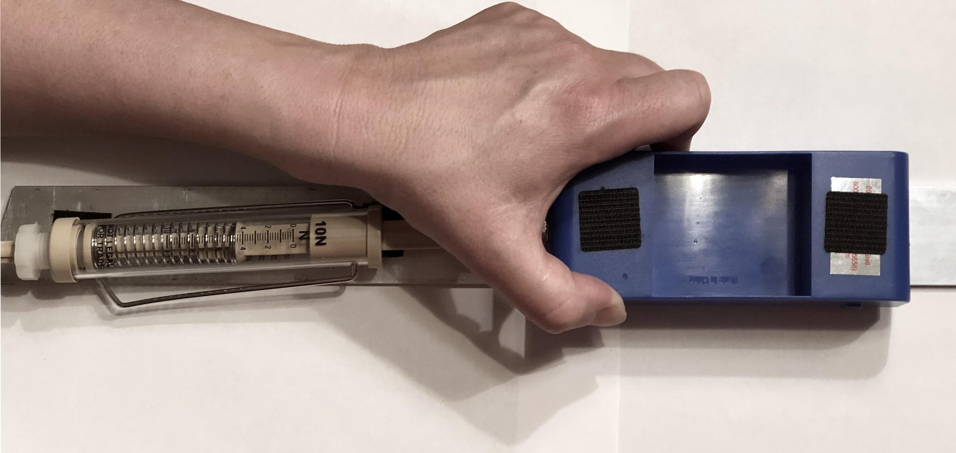
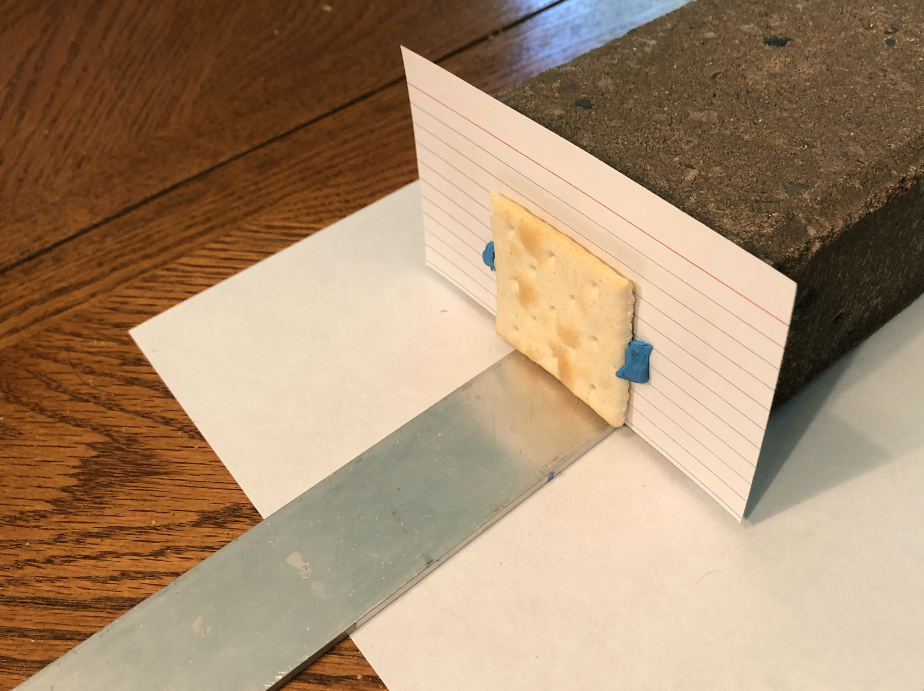
Slide B
Planning Investigation 1
Notes:
Show slide B. Say, Because you need a repeatable way to launch the cart at the same speed in condition B as you did in condition A, we are going to use a spring scale as a launcher. Let’s think about how using a spring scale as a launcher can help us do that.
Ask the questions in the teacher guide to raise issues related to the spring scale’s use, the accuracy of the launch method, and the need to calibrate the system.
Motivate the need for multiple trials and calibration for each condition based on these possible sources of error. Say, The sources of error we’ve identified mean that before adding the damage target, the cracker, to the setup you will want to do a few trials to make sure you are confident that the speed of the launch isn’t changing when you launch the cart from the same launch position every time. Follow the procedure you will receive as it will describe this in more detail and will provide you steps on how to ensure that you capture all the pieces that might fall off the damaged object, the cracker, on a piece of paper under the brick. An image of this is shown on the slide.

Slide 3

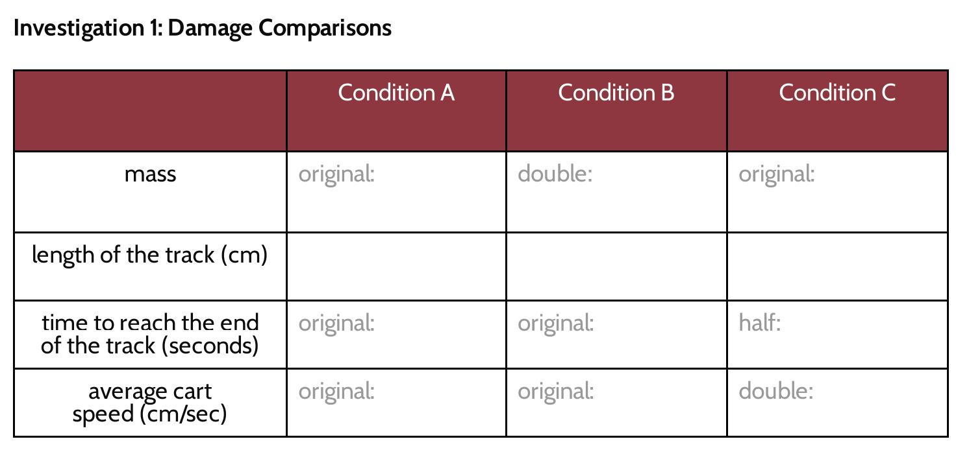
Slide C
Preparing for Investigation 1
With Your Group
Add the handout to your notebook.
Review the procedure before carrying out the investigation.
Notes:
Show slide C. Distribute Procedure for Investigation 1 to students. Point out where in the room you want students to bring their damaged test objects (broken crackers and the index cards they were attached to with sticky putty and the papers used to collect the related debris from these crackers) at the end of their investigation, such as a back table or counter. Ideally this is a place students can either pull their chairs around or gallery walk along to be able to see the results. The purpose here is to provide them a space where everyone can do a quick glance over multiple sets of results quickly.
Monitor groups as they carry out investigation 1 following the procedure on Procedure for Investigation 1.
Argue for what the data show us. Gather students around the pooled class results (crackers on paper) or give them a couple minutes to do a gallery walk past all the collected results. Ask students to study the results and be prepared to make an argument for the answer to this original question based on our results:
How much does doubling the speed or doubling the mass affect the kinetic energy of an object and the resulting damage that it can do in a collision?
Briefly discuss what the data tell us. Students will argue that doubling the speed of a moving object has a bigger effect on its kinetic energy, which causes it to have a greater amount of damage. Ask multiple students to weigh in on how the evidence supports this conclusion. Students should say that objects from condition C (doubling the speed) show more damage (more pieces and/or more cracks) in them than the same objects from condition B (doubling the mass).
Problematize the unanswered part of our question (quantifying “how much”). Say, Though we can use our observations to argue that doubling the speed of a moving object has a greater effect on its kinetic energy than doubling its mass, our original question we were investigating was asking us “How much does doubling the speed or doubling the mass affect the kinetic energy of an object and the resulting damage that it can do in a collision?” Knowing how much of an effect one thing is having on something else can be answered through simply ranking our results to determine which thing has a bigger effect. But knowing specifically how much more is not something we can say unless we have some sort of way to quantify all the variables that are part of this question. We have a way to quantify the mass and speed of an object, but we don’t have a way yet to quantify the amount of kinetic energy that object has.
Introduce the potential advantages of a quantitative measure of kinetic energy. Say, Finding a way to quantify how much kinetic energy an object has when we change its mass or its speed could provide us another tool for explaining why some things get damaged in a collision and others don’t. It could also help us more precisely predict the amount of damage a moving object could do and maybe even give us ideas about ways to design solutions to prevent such damage from happening.
Introduce a way to quantify the relative amounts of kinetic energy an object has. Say, Scientists and engineers have developed different ways to measure and compare how much more kinetic energy one object has compared to another. One of those ways is to measure the entire distance over which two objects push on each other during a collision. This method involves colliding the moving object into a stationary object in such a way that the object that was moving remains in contact with the object it collided with and continues to push it along a surface until both have stopped moving, without causing any damage. Let’s see what an example of this method looks like.
Orient students to an example of such a measurement by showing this video clip: https://youtu.be/ygLbCFuqYFo.
Share likely sources of error in the system. Say, We have seen the result from only one trial for one condition. If the person who made this video ran multiple trials for this one condition, using the same mass and speed each time, why might it be reasonable to still expect that there would be some amount of variation in how far the box is pushed in each trial? What might cause that variation? Anticipated responses will reference sources of error students mentioned earlier in the lesson.

Slide 4

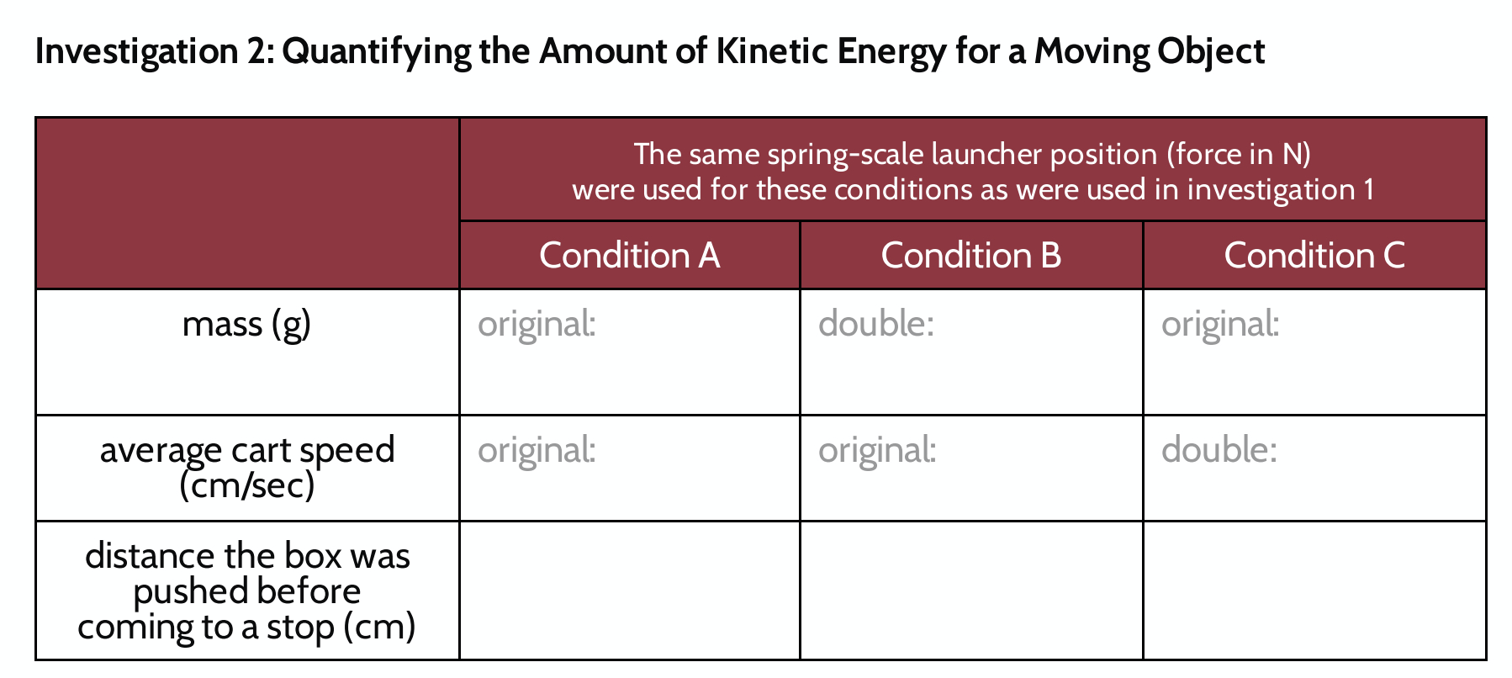
Slide D
Recording Data from Investigation 2
On Your Own
Watch condition A again and record the related data in your investigation 2 data table.
Watch Condition A
Notes:
Say, If we know there might be slight variation in the results, let’s look for some really general patterns in the data from just one trial of the same three conditions we collected data on with our first investigation.
Show slide D. Explain to students that you will show the video again and that they should prepare to record the related data for investigation 2 on Changes in Kinetic Energy: Investigations #1 & 2. Show the video for condition A again: https://youtu.be/ygLbCFuqYFo. Pause the video as needed. Give students a minute to record the related data.

Slide 5

Slide E
Making Predictions
Turn and Talk
Discuss your predictions:
When we double only the mass of the cart, how much further will it push the box?
When we double only the speed of the cart, how much further will it push the box?
Notes:
Show slide E. Have students turn and talk about the questions on the slide.
When we double only the mass of the cart, how much further will it push the box?
When we double only the speed of the cart, how much further will it push the box?

Slide 6
Slide F
Recording Data from Investigation 2
On Your Own
Watch conditions B and C and record the related data in your investigation 2 data table.
Condition B
Condition C
Notes:
Show and record data from the related videos. Show slide F.
Show video 2: https://youtu.be/XgczgVAiCYk. Give students a minute to record the related data in their investigation 2 data table on Changes in Kinetic Energy: Investigations #1 & 2.
Show video 3: https://youtu.be/3Rzt0wNQAT0. Give students a minute to record the related data in their investigation 2 data table on Changes in Kinetic Energy: Investigations #1 & 2.
The the values that students will end up recording in their data table for investigation 2 can be found in the teacher guide.

Slide 7
Slide G
Analyzing the Results and Making Predictions
With a Partner
About how many times further did the box get pushed when the mass was doubled?
About how many times further did the box get pushed when the speed was doubled?
What does this tell us then about how much more kinetic energy the cart had in each case?
Based on these patterns, make a new set of predictions:
If you tripled only the mass of the cart, how many times further will it push the box?
If you tripled only the speed of the cart, how many times further will it push the box?
Be ready to share your ideas with the class next time.
Notes:
Show slide G. Have students turn and talk about the questions on the slide. Give three minutes for this discussion:
About how many times further did the box get pushed when the mass was doubled?
About how many times further did the box get pushed when the speed was doubled?
What does this tell us then about how much more kinetic energy the cart had in each case?
Based on these patterns, make a new set of predictions:
If you tripled only the mass of the cart, how many times further will it push the box?
If you tripled only the speed of the cart, how many times further will it push the box?
Summarize that we will revisit these predictions next class to help us develop a mathematical model for quantifying the amount of kinetic energy an object has in order to be able to more accurately predict and explain what causes damage in some collisions and not others.

Slide 8

Slide H
Sharing Results and Predictions
As a Class
About how many times further did the box get pushed when the mass was doubled?
About how many times further did the box get pushed when the speed was doubled?
What does this tell us then about how much more kinetic energy the cart had in each case?
Based on these patterns, make a new set of predictions:
If you tripled only the mass of the cart, how many times further will it push the box?
If you tripled only the speed of the cart, how many times further will it push the box?
Notes:
Show slide H. Cue students to look back at the results they recorded for investigation 2 on Changes in Kinetic Energy: Investigations #1 & 2. Discuss the questions on the slide.
Connect to the idea of scale factors from math class. Say, When you are saying you predict the new value compared to the old value will be 3 times more or 6 times more, you are describing the ratio of the new value to the old value as a scale factor.
Motivate the need for a mathematical model. Say, Notice that just one set of results is allowing us to make more mathematically precise predictions about the effects of scaling up the mass or speed by a different scale factor than 2. More data could help us develop an even more general mathematical model so that we can accurately predict how any change in the mass or change in the speed of a moving object would affect its kinetic energy. But to develop such a general mathematical model we are going to need more data.
Problematize the limitations of the setup shown in the video. Emphasize that the track we used is only a meter or less long and that is true of the track we saw in the video too, so in our classroom space and with the limited supplies we have, we would run out of space and/or track if we keep increasing the kinetic energy of the cart and try to see how far it pushes the box.
Recall previous examples where students used computational simulations study. Say, You’ve seen many cases in your previous science work when you were limited in your ability to study the entire system in some way. Sometimes when this happened, you switched to using a computational simulation to collect additional data. What were some of the systems you’ve studied where you’ve used a computational simulation to collect additional data about the system?
Students will say things like these:
particle collisions in Cup Design Unit
absorption of food in the small intestine in Inside our Bodies Unit
photosynthesis in the chloroplasts of a leaf in Maple Syrup Unit
orangutan ecosystem interactions in Palm Oil Unit
Introduce the computational simulation students will use for investigation 3. Say, Let’s prepare to collect some additional data from a computer simulation that will allow us to further explore the relationship between the mass and speed of a moving object and its kinetic energy. First let’s orient ourselves to the interface we will be using.
Demonstrate a model run for the default simulation settings. Load the simulation, located at https://www.openscied.org/collision2-simulation/. After the model loads, press “setup” and ask students what they notice. They will say that they see a cart, a track, and a box.
Press “go/pause” and run the model. Ask students what they notice. They will say that the cart coasted down the track and ran into the box and pushed it a certain distance down the track.
Ask students, using the prompts located in the teacher guide, how this simulation would allow us to collect the data we need to answer the question we have been considering.

Slide 9
Slide I
Preparing for Investigation 3
On Your Own
Title a new page in your notebook: What is the relationship between change in the mass or the speed of a moving object and its kinetic energy?
Set up two data tables in your notebook:
Mass of the moving object for a fixed speed | Kinetic energy of the cart (measured as the distance the box is pushed)
Speed of moving object for a fixed mass | Kinetic energy of the cart (measured as the distance the box is pushed)
Notes:
Set up data collection tables. Show slide I. Distribute two copies of Graphing Kinetic Energy Relationships to each student as students are setting up their science notebooks to collect their data. Ask students why they will need two pieces of graph paper. They will say that they will need one for each data table or one for the effects of speed changes on kinetic energy and one for the effects of mass changes on kinetic energy.

Slide 10

Slide J
Carrying Out Investigation 3
On Your Own
Use the simulation to carry out your investigation.
Record your results in your data tables
Create a coordinate graph for each of your data tables:
Title both of your graphs.
Label your axes and intervals.
Plot your data as coordinate points.
Notes:
Provide instructions for investigation and graph creation. Show slide J. Tell students that you want to collect their graphs at the end of the investigation as a formative assessment.
Cue students to launch the simulation (https://www.openscied.org/collision2-simulation/) on their own computers.
Monitor students during the investigation. Seven minutes into the investigation, cue students to start graphing their data if they have sufficient data in their data tables. This will leave eight minutes for developing the graphs, which some students will need, particularly since they are setting up the x-axis and y-axis and related intervals for both graphs on their own.

Slide 11
Slide K
Analyzing and Interpret the Results of Our Investigation
With a Partner
What patterns do you notice in your graphs and tables?
Use these patterns to calculate how much the kinetic energy of a moving object should increase if
it had three times as much mass but the same speed.
it had three times as much speed but the same mass.
In math we sometimes try to represent patterns between two variables using symbolic expressions. How might we do that for the following relationships?
mass and kinetic energy
speed and kinetic energy
Be ready to share your ideas with the whole class.
Notes:
Show slide K. Give students 4 minutes with a partner to discuss the questions and do the calculations described on the slide. After this, discuss these questions as a whole class. Example prompts and responses are located in the teacher guide.
Start an anchor chart where you can summarize the relationships. Say, We can represent that relationship in a general way. Add a title to the poster: “How changes in mass and speed affect the amount of kinetic energy an object has”
Under this add the following:
For changes in mass
however many times more mass there is
= however many times more kinetic energy there is
Ask about scaling down the mass. Example prompts and responses can be found in the teacher guide.
Suggest that what we wrote should also therefore have the phrase “or fraction of it there is” in it to show that we can scale the mass up or down and the amount of kinetic energy scales up or down accordingly. Add this phrase to the statement on the chart paper.
For changes in mass (this is a linear, directly proportional relationship)
however many times more mass there is or fraction of it there is
= however many times more kinetic energy there is or fraction of it there is
Shift to describing and representing the relationship between speed and kinetic energy. Say, What about for the general relationship between speed and kinetic energy?
Say, We can represent that relationship in a general way. Add this to the chart paper:
For changes in speed (this is a nonlinear relationship)
(however many times more speed there is or fraction of it there is)²
= however many times more kinetic energy there is or fraction of it there is
Celebrate that we have a way to quantify changes in kinetic energy. Say, We made some real progress in figuring out a mathematical model that predicts how changes in mass versus changes in speed affect the kinetic energy of a moving object. But how does this help us more fully explain our anchoring phenomenon? Early in our work we said there is energy being transferred in collisions and that there are forces at work too. Let’s try to unite those two perspectives more fully by thinking about all the places energy is getting transferred in our launcher system.

Slide 12

Slide L
Applying Our Ideas
Let’s reflect on what we figured out across the three investigations and how this helps us predict and explain why things sometimes get damaged when they hit each other and sometimes they don’t.
Individual Explanations
At the end of the period, turn in your responses to the questions on your Looking back handout along with the two graphs you made from your investigations.
Notes:
Have students connect what we have figured out back to our anchoring phenomenon. Show slide L. Distribute Looking back: Explaining and predicting kinetic energy changes in the system. Emphasize that this is a formative assessment that you want to collect along with the graphs at the end of the period and that it focuses on the work we have done in this lesson. Give students the remaining time to complete the questions on Looking back: Explaining and predicting kinetic energy changes in the system and have them turn this in along with their graphs at the end of the period. Students may use their science notebooks as reference for this task. If time is short, assign this as home learning to turn in at the start of the next lesson or move it to the start of that lesson as an entrance ticket.
Unite two additional ideas related to energy transfer. Say, You’ve just used the model we developed to explain how changes in the mass or the speed of an object would affect whether damage would result in a collision. This model uses kinetic energy of a moving object as an important way of predicting what will happen in a collision.
Refer to the Interactions in the System poster you made at the end of Lesson 2 that summarized an energy perspective and a force perspective in a collision. Point out that this poster reminds us of how we initially argued that energy is transferred in collisions and that there are forces involved.
Problematize where the energy is coming from and going to in the system. Say, But when we initially made this poster you provided a lot of examples of other systems where you tracked the energy flow across the system. You gave examples of phenomena that included things like cold liquid in a cup warming up or the formation of a hailstorm or the changes in the size of orangutan populations as a result of changes in the amount of accessible fruit trees in a forest ecosystem. In all these examples, we tried to track where the energy came from and where it went to in the system in order to better understand the phenomena.

Slide 13
Slide M
Navigation
Let’s try to track where the energy came from and where it went to in the cart, spring scale launcher, track, box, and cracker system in order to better understand what is happening in that system.
Turn and Talk
Where did all the kinetic energy the cart had before the collision come from?
After the collision, where did that energy go?
What new questions does this raise for you?
Be ready to share your ideas with the whole class next time.
Notes:
Problematize where the energy comes from in the system and where it is going. Say, Thinking about where the energy is coming from and where it is going in a collision could help us understand and explain even more about collision-related phenomena. So let’s consider an energy perspective for the entire system we used in this lesson with the cart, spring scale launcher, track, cracker, and box.
Show slide M. Have students turn and talk to discuss the questions on the slide.
Save the last minute to have students make note of what new questions they have. If time permits you could have them write these new questions on sticky notes and add them to their science notebooks to share next time. Either way, suggest to the class that we will pick up our next lesson with this line of thinking by having students share some of the new questions that they are now considering about the entire system we used in the first two investigations in this lesson.

